Slide 1

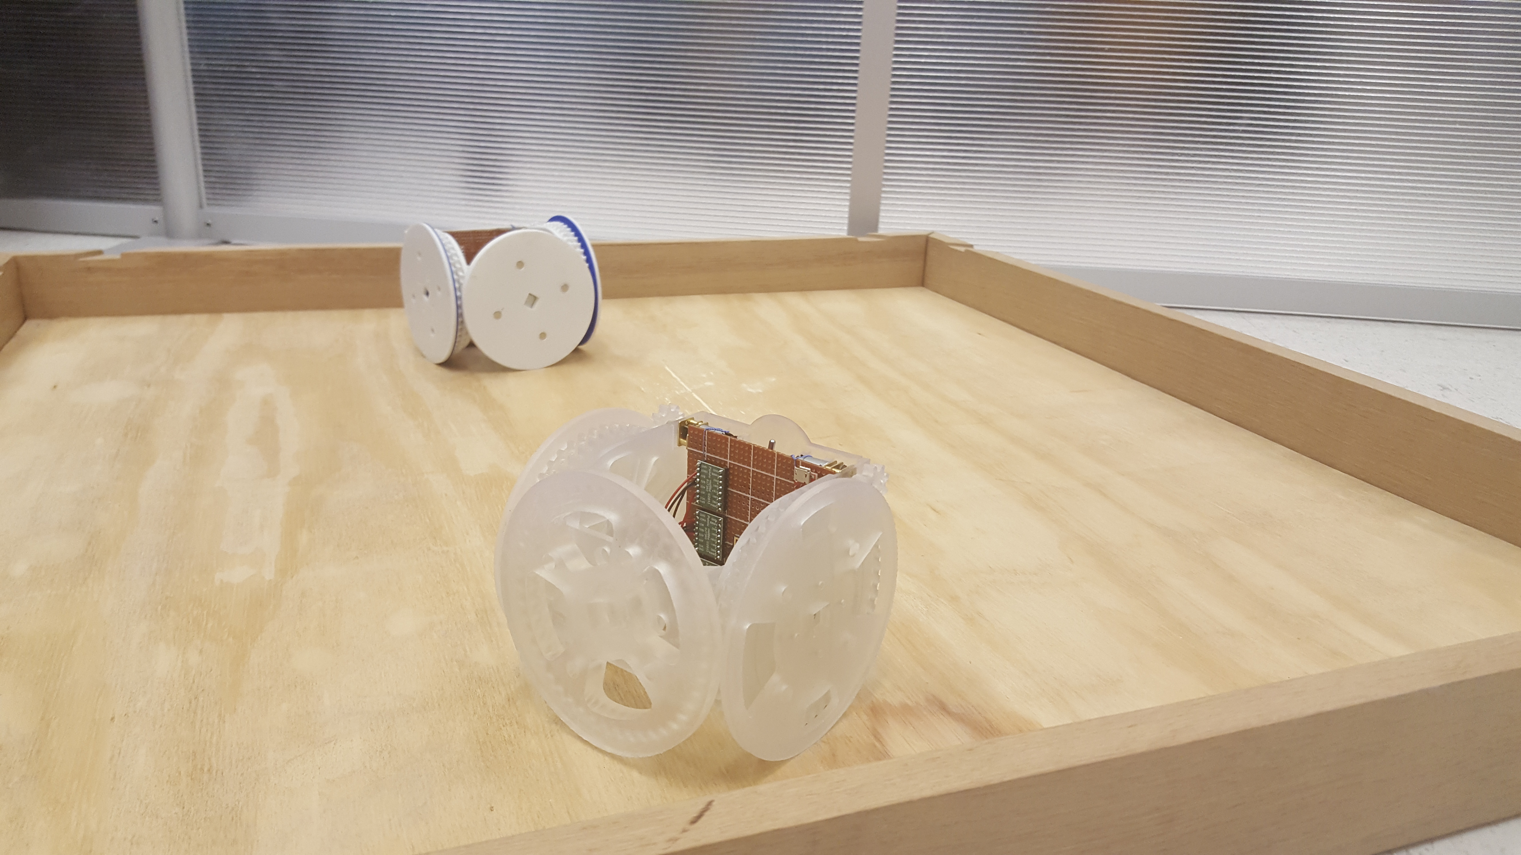

Real Autobots and Decepticons
Carter Chase, Jeff Ross, Trevor Seitz, Ben Smith
Department of Computer Science
Advisor: John Licato, Ph.D., Sponsor: ACoRL
Summary
Problem Statement
Artificial Intelligence
From Transformers to Big Hero 6, self-configuring robots have captured imaginations. Just imagine a world where construction scaffolding can be stored inside a box and assemble itself on demand. A world where maintenance machines can enter a nuclear reactor and adapt to changing conditions. A world where tiny robots can be injected into a person’s blood to repair damaged organs. The possibilities are endless.
In a first for the IPFW Computer Science Department, our team cooperated with the Electrical and Computer Engineering department, to build and program self-configuring robots. Our team was tasked with constructing the infrastructure and algorithms to control the robots. Our end goal was to design a system that can arrange the robots into formations from random starting points.
Unaided organization of modules into a predetermined formation from random starting points.
Our AI progresses through 4 phases. The AI is iterative, which means that it performs these phases several times until each robot is in position within a desired error.
Recognition
The AI uses existing sensors to determine the location of the robots.
Alignment
The AI generates the commands that will align the robots onto a “virtual” grid and orient it to a common “north.”
Goal Assignment
The AI determines the goal position of each robot. The goal position is derived from the robot’s position in the desired formation.
Pathfinding
The AI generates the commands that each robot needs to follow in order to get to it’s goal state.
Design
Conclusion
Our team adopted the approach of using a centralized control algorithm rather than a distributed algorithm. To this end, we designed a centralized controller which uses Bluetooth to communicate with all the robots. The controller consolidates the sensor data before feeding it into an artificial intelligence (AI) algorithm. Finally, this AI processes the sensor data and creates the commands that the robots need to follow to make the formation.
While our project does not produce a true “configuring robot,” it has us well on our way. We have established the infrastructure for controlling and communicating with the robots. We have laid the groundwork for the algorithms to create and execute more sophisticated formations. Future goals of this project would be to create 3-dimensional formations and allow for synchronized movement of arranged robots.
Self-assembling MOdular Robot for Extreme Shapeshifting (SMORES) used in our project.
Interested in our work? You can follow our progress at https://github.com/car-chase/amoebots

